Slide 1
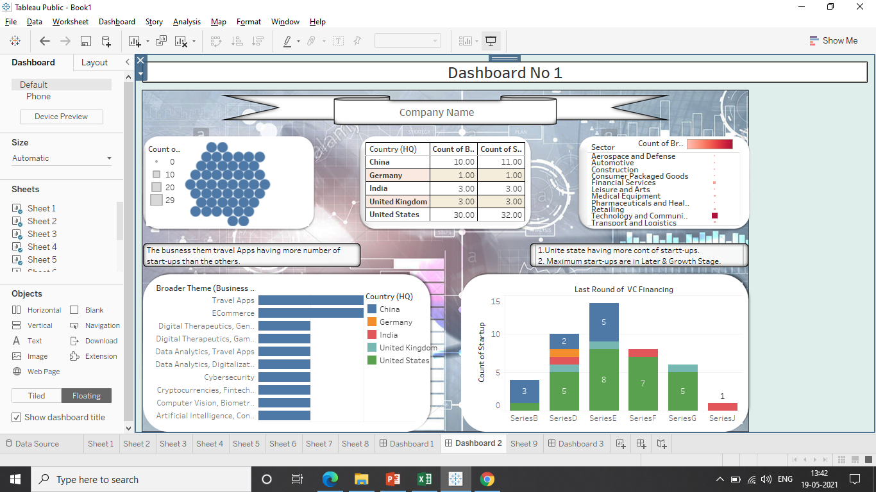

Slide 2
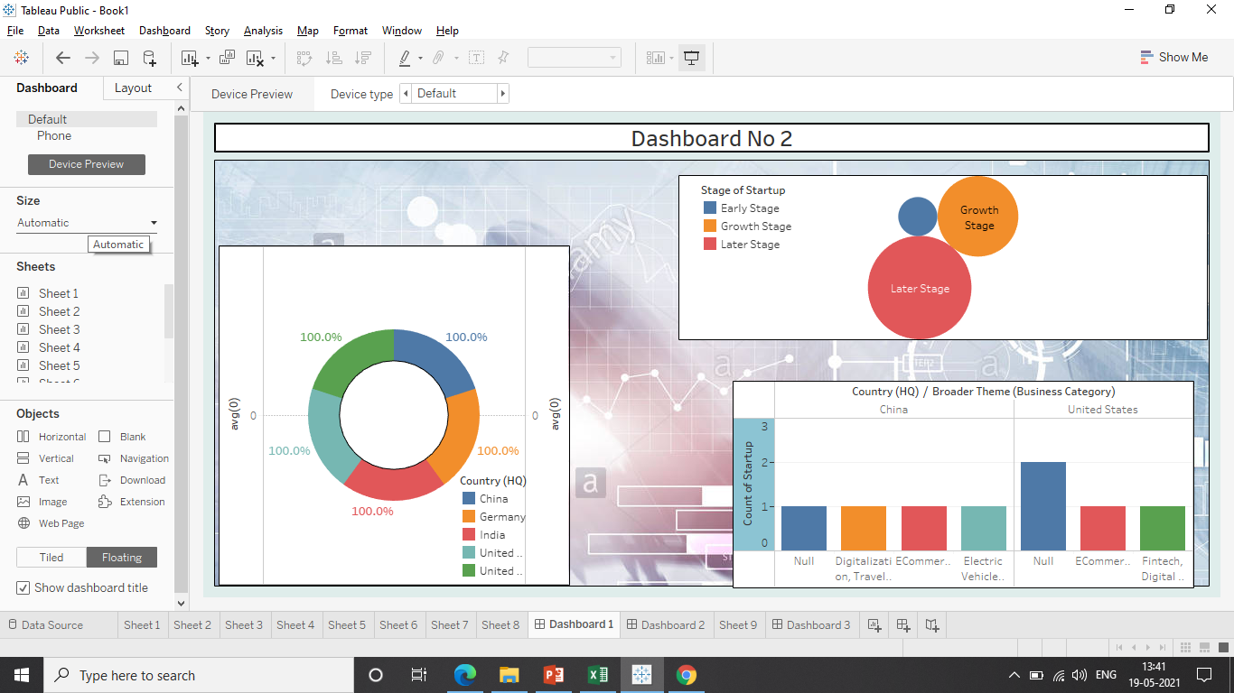

Slide 3
ESTIMATE
SR NO | ACTIVITY | RATE/HR | HOUR SPENT | AMOUNT
1 | Data understanding and cleaning | 150 | 2HR | 300.RS
2 | Creating KPI and target parameters | 150 | 1HR | 150.RS
3 | Creating wireframe | 200 | 3HR | 600.RS
4 | Development of sheets | 300 | 5HR | 1500.RS
5 | Calculation & observations | 300 | 2HR | 600.RS
6 | Finding Insights | 350 | 1HR | 350.RS
7 | Development of dashboard | 400 | 4.5HR | 1800.RS
8 | Creating story | 300 | 1HR | 300.RS
9 | Final presentation & conclusion | 500 | 2.5HR | 1250.RS
Total Estimate |  |  |  | 6850.RS
*18% GST will add in total estimate (Total Estimate + 18% GST).

